Slide 1





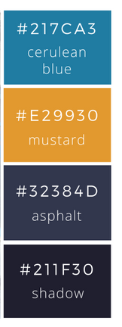
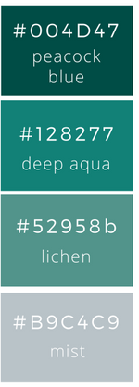

To Do list
20th Jul, 2020
Location : Meeting room 1
Target in this week
Result on last week
Achieved
On process
Not Achieved

Slide 2
To Do list
Result on last week
Target in this week
TUE
WED
MON
MON
TUE
WED

